Slide 1
Target Customer Definition
“Now that I have my idea and team, what do I do next?”

Slide 2
Guru
A software product that guides high school students with 2200 boards and A averages...through applications to elite colleges... which can increase their chances of admission from 6% to 50%

Slide 3
“Elite”- a training device
Device measures “relative” energy, sleep, heart rate ... so that coaches can design a workout program for each athlete each day

Slide 4
HR Vision
A software program that
• measures “happiness” and
• can predict when key employees are on the brink of leaving

Slide 5
What is the singular necessary and sufficient condition to have a company?
If you have a paying customer, does it mean you have a good business?
Need enough paying customers within a short period of time so that you become profitable

Slide 6
How to start a business?
By building a product,hiring developers or recruiting salespeople?
Find an unmet need
Build your business around it
Market/Customer-Driven

Slide 7
Creating a new market
Creating innovative product where no market currently exists is essential to success
You will get dominant market share in that market
Use as a basis for further expansion
Don’t try to sell to everyone (You don’t have the resources)
Me-too company in an existing market is very difficult for a startup
Avoid “China Syndrome”-choose huge existing market, get a fraction of market share and reap the rewards
At the center of the target.... Those who ABSOLUTELY, POSITIVELY WANT YOUR PRODUCT!!!
How many? At what price? Through which channel?
Guru?Elite? HR Vision?
(Breakout room)

Slide 8
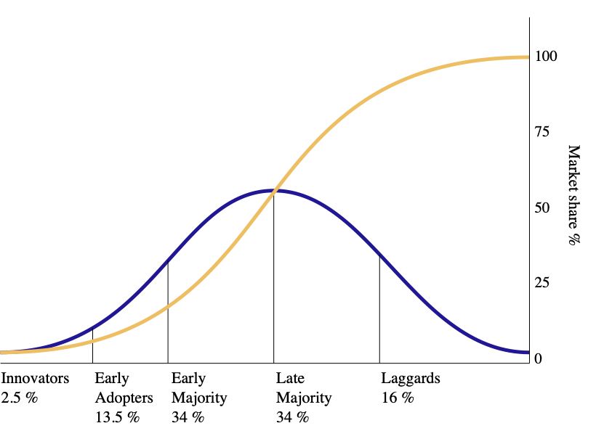
Diffusion of innovations (Rogers, 1962)

Slide 9
Technology Adoption
Innovators
Willing to try anything new,, have the highest social status, have financial liquidity, are social and have closest contact to scientific sources and interaction with other innovators. Love new products.
Early adopters
These individuals have the highest degree of opinion leadership among the adopter categories. They want to exploit discontinuity caused by innovations.
Early majority
Believe in evolution, not revolution. They make bulk of purchases
Late majority
Price sensitive, demanding and skeptical. Huge untapped market for tech companies
Laggards
They are the last to adopt an innovation. Laggards typically tend to be focused on "traditions". Love to challenge the hype. Idea is not to sell to this group but around them

Slide 10
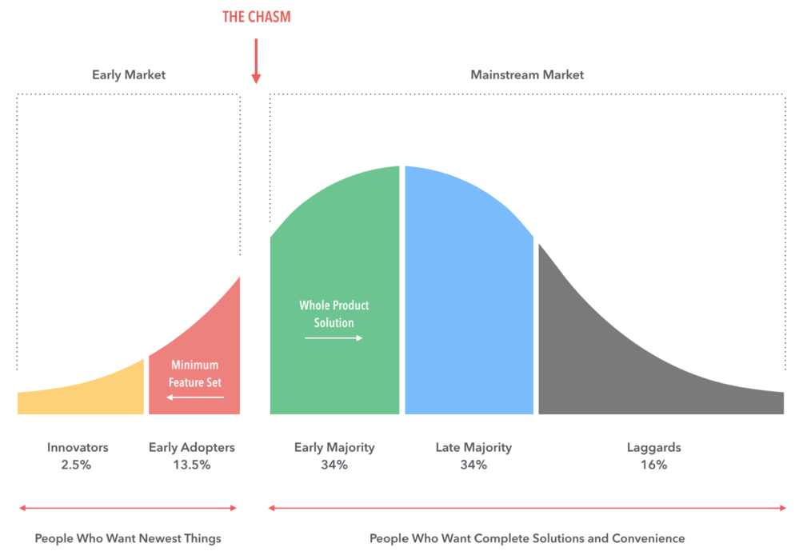
Chasm model (Geoffrey Moore)

Slide 11
Chasm model
First two categories represent people who are willing to try anything new
After this honeymoon comes the chasm or tornado that can make or break your company
After the initial excitement, market waits for a complete solution that meets all their requirements

Slide 12
The bowling alley
Launched a new product with a chosen beachhead
Now you enter bowling alley (still far from the tornado)
Must use initial beachhead customer as lead bowling pin to get a wide market share
Focus on niche market to validate your idea
Identify a clear problem or an underserved area and solve the problem

Slide 13
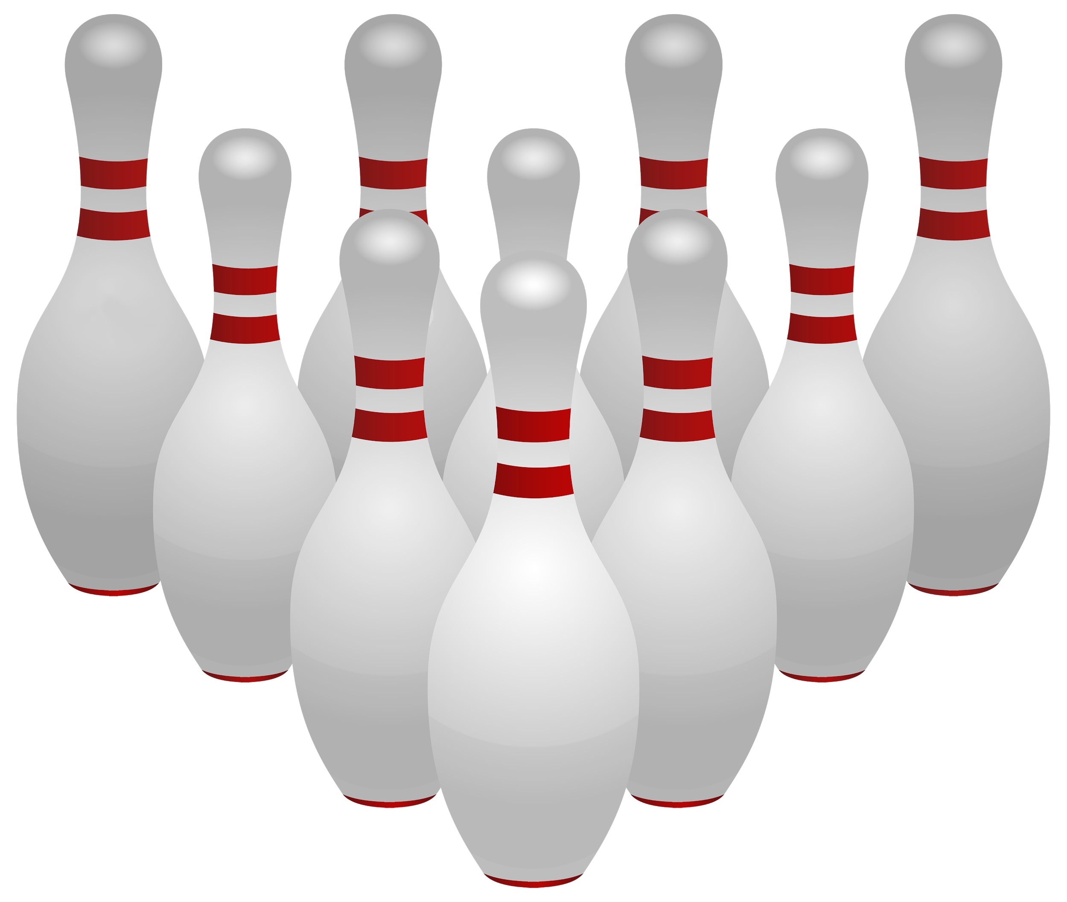
Bowling alley
Product improvement
Word of mouth

Slide 14
The innermost circle
Will be 10 X as likely to buy your product as the next circle...
The second circle will be 5 X as likely as the third circle..

Slide 15
Your problem...
• You don’t exactly know who is in the innermost circle

Slide 16
Zen and the Art of Entrepreneurship
Target customer is a group of potential customers who share many characteristics and would have similar reasons for buying a product
Become one with your customer
Make the lines very blurry between you and your target customer
Empathise with the target customer and learn the pain points
Primary market research essential for creating new markets
Not educated assumptions or third party analysis

Slide 17
Your problem...
• You don’t exactly know who is in the innermost circle

Slide 18
Create Great Focus
Persona is critical
Creates concrete focus – is this what the persona would value? Pay for?
Critical to also understand the DMU and DMP
You will have to address each key player
This will not happen on Day 1 but will evolve over time and you know what the goal is
But finding your target customer is essential ... and a testable hypothesis

Slide 19
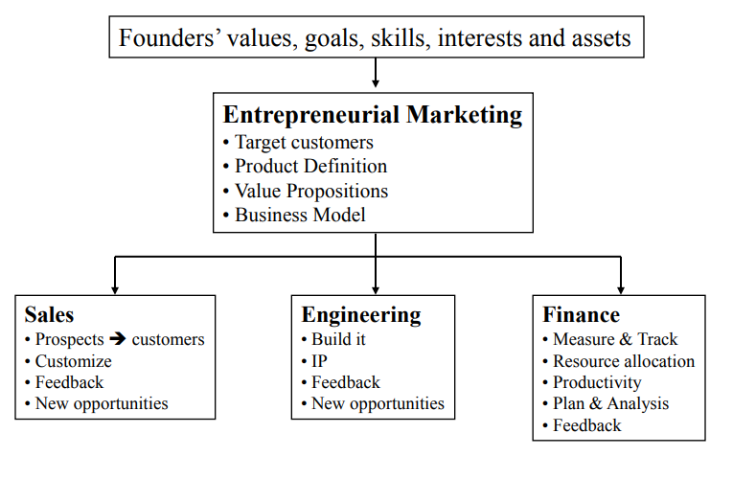
Logical Flow

Slide 20
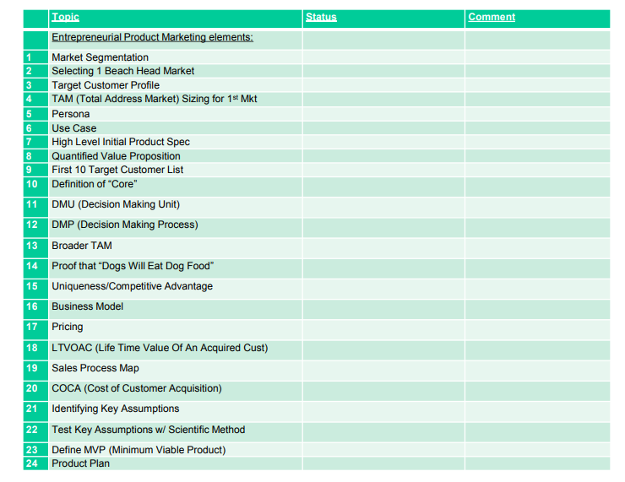

Slide 21
The Keys To Success with this Process
All the following analysis must be done by deeply engaging with potential real customers with an open mind (not selling to them) and carefully listening to what they say and what is really meant.
Getting strong relationships with potential customers and really understanding their needs and the value you can bring them is the real gold in this process.
Of course you need strong analytic skills and a fast clock speed to get this done but usually it is the last of on going honest customer dialogue that undermines the value of this process.

Slide 22
Step #1: Market Evaluation
Systematically identify and evaluate the top market opportunities.
This generally is a long process but it is important to not let it go on indefinitely.
There will likely be many paths to success and it is important that you choose one but not necessarily the perfect one. There likely is no perfect one.
It is better to try a market and find out if it will work out and learn that it will not rather than be a state of “analysis paralysis”.
Set a reasonable time frame and aggressively explore multiple markets in an exploratory fashion with primary open mind market research techniques.

Slide 23
Step #2: Select One BeachHead Market
After a sufficient period of evaluation, choose one opportunity and pursue it with great focus.
It does not have to be the biggest opportunity or clearly the best opportunity, but it does have to be a beachhead application with sufficient size, profitability and significance.
When you win it by providing a substantially superior product, it will produce positive cash flow for moving into adjacent markets

Slide 24
Market Analysis Criteria: How to Chose Beachhead Segment
Is the target customer well funded and are they readily accessible to our sales force?
Do they have a compelling reason to buy? (They may be managing quite well without it)
Can we today, with the help of partners, deliver a whole product to fulfill that reason to buy?
Is there no entrenched competition that could prevent us from getting a fair shot at this business?
If we win this segment, can we leverage it to enter additional segments?
You should be able to scale up
Can we show results in a one to two year timeframe?
Short 6-12 market opportunities

Slide 25
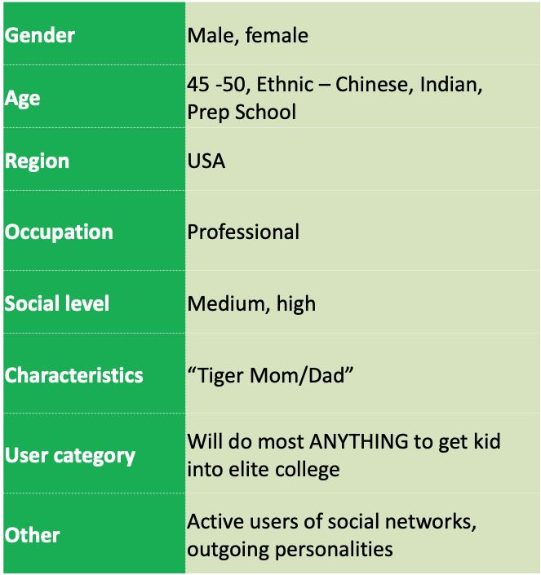
Target customer profile

Slide 26
Step #4: TAM Sizing for 1st Market
Make a first pass TAM (Total Addressable Market) calculation on this first market. This is how much annual revenue there is available to you for your product if you achieved 100% market share.
This is only for your first “beachhead” market which you should be able to do with some clarity.
The strong preference is for a bottoms up type of analysis where you can show from your primary market research how many of the potential customer you have identified and then extrapolate this to the broader market.
Complementary to this but much less compelling on its own, is a tops down analysis where you are working with market analysis reports and extrapolating without direct interaction and validation. Often, very important subtleties are missed in tops down analysis.

Slide 27
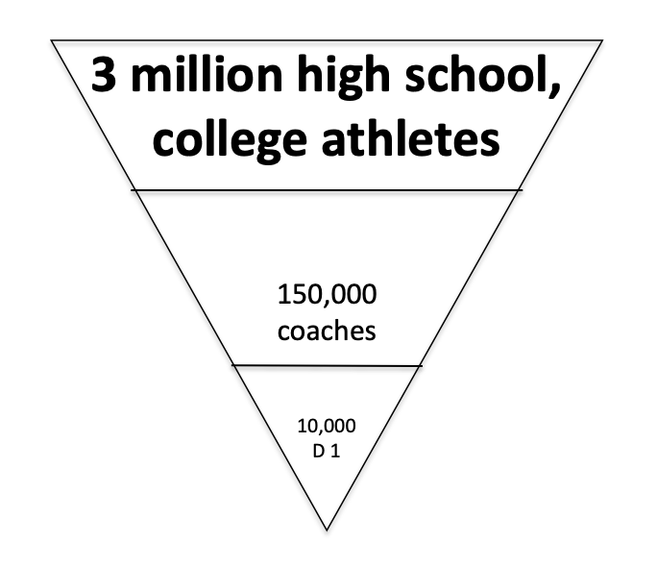
Elite Training

Slide 28
Step #5: Persona
Build a Persona that very clearly and viscerally visualizes target customer decision maker/end user to all involved.
Persona should not just be a factual description of buyer but also social and emotional factors such as what incents them, their priorities, what they fear, what industry groups they belong to and other systemic factors that will influence purchase and adoption of your product.
Your persona should be a real person but also representative of broader market so that if you meet the persona’s need, the others will be equally pleased.

Slide 29
Persona Example
Chuck Kirby, Facilities Manager, IBM NE Data Center in Littleton, MA
20K Blade servers today growing at 15% per quarter for past two year and for the foreseeable future
Second generation American
Lives in Medford
Medford High to Middlesex Community College
Moved to Winchester
Family with 2 kids (12, 15)
Mid-career, many years at company, technical, maintenance focus, vocational degree
Been in job for 5 years and seen three managers already
Promotion path forward is to manage more facilities
AFCOM, Uptime Institute, Green Grid, starting to read blogs (Hamilton & Manos)
Ford 150 pickup truck, Beeper always on, volunteer fireman mentality
Customers’ Customer and Their Priorities

Slide 30
Step #6: Use Case
Develop and step through in detail an illustrative and pretty standard Use Case for the need, acquisition and benefits of your offering.
It is extremely important to go all the way through a use case with your target customer of first how your product/service will work for the target customer.
How exactly does it fit into the value chain?
What are the key interface points?
Why exactly would they acquire it?
What barriers to adoption might arise?
It is also important to extend your use case to not just how the target customer would use your product but then to the wider acquisition and post installation support process.

Slide 31
Step #9: First 10 Target Customer List
Now that you understand your customers well and you have a use case and value proposition, make a list of the Top 10 Target Customers that will benefit from your product after you sell it to the first one from the persona you described above.
Hopefully you have already spoken to these customers and you have some level of commitment from them to acquire, test or pilot your product once it is available.

Slide 32
Customer Market Customers
Focus on your first market only
Richly describe your target customer in all dimensions
Name them specifically – do a use case all the way through
Describe the “as-is” state
Name the ones you specifically have spoken to who have this pain/opportunity
Describe Key Characteristics of target customers/market. Describe their ability to get funding to buy new solutions. What is the compelling factor/event that will make them buy? Who are other entrenched players?
Extrapolate this to a Broader Market (Sizing the overall TAM). Then return to specificity by naming the next 10 target customers. If successful, what would be your next logical market?

Slide 33
Looking ahead
By now your team should be formed and finalized
Next class we focus on Primary Customer Research

